Slide 1
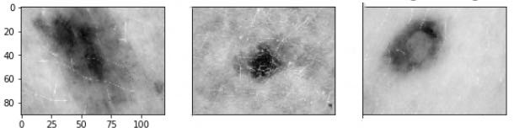
BME 590L Final Project:
Optimizing Gray-scale Image Formation Parameters in CNN Skin Caner Detection
Yangpei Liu, MS, BME
Changxiang Sui, MS, BME
Sumin Lan, MS, BME

Slide 2
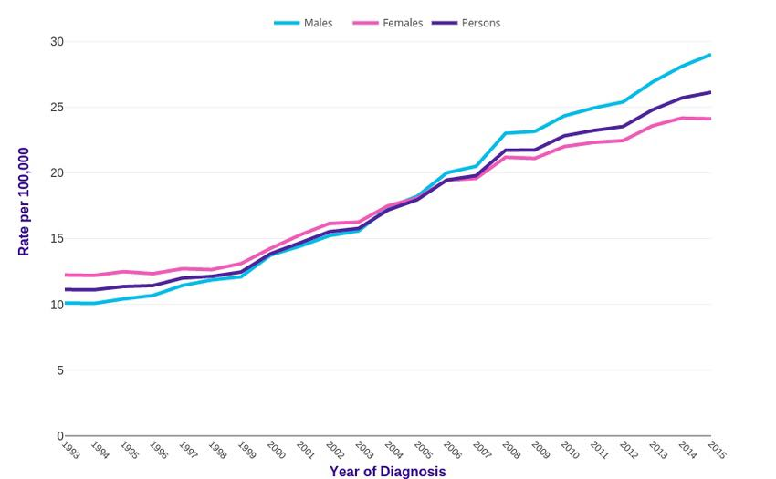
Problem Description
Skin Cancer Trends^{[1]}
A significant number of people throughout the world are affected with skin cancers.
These data show a rapidly rising incidence of skin cancers over the past 22 years.
[1] Detecting Melanoma Cancer using Convolutional Neural Networks - Scientific Figure on ResearchGate. Available from: https://www.researchgate.net/figure/Melanoma-skin-cancer-trends-Source-UK-Cancer-Research_fig4_333199776 [accessed 22 Apr, 2020]

Slide 3
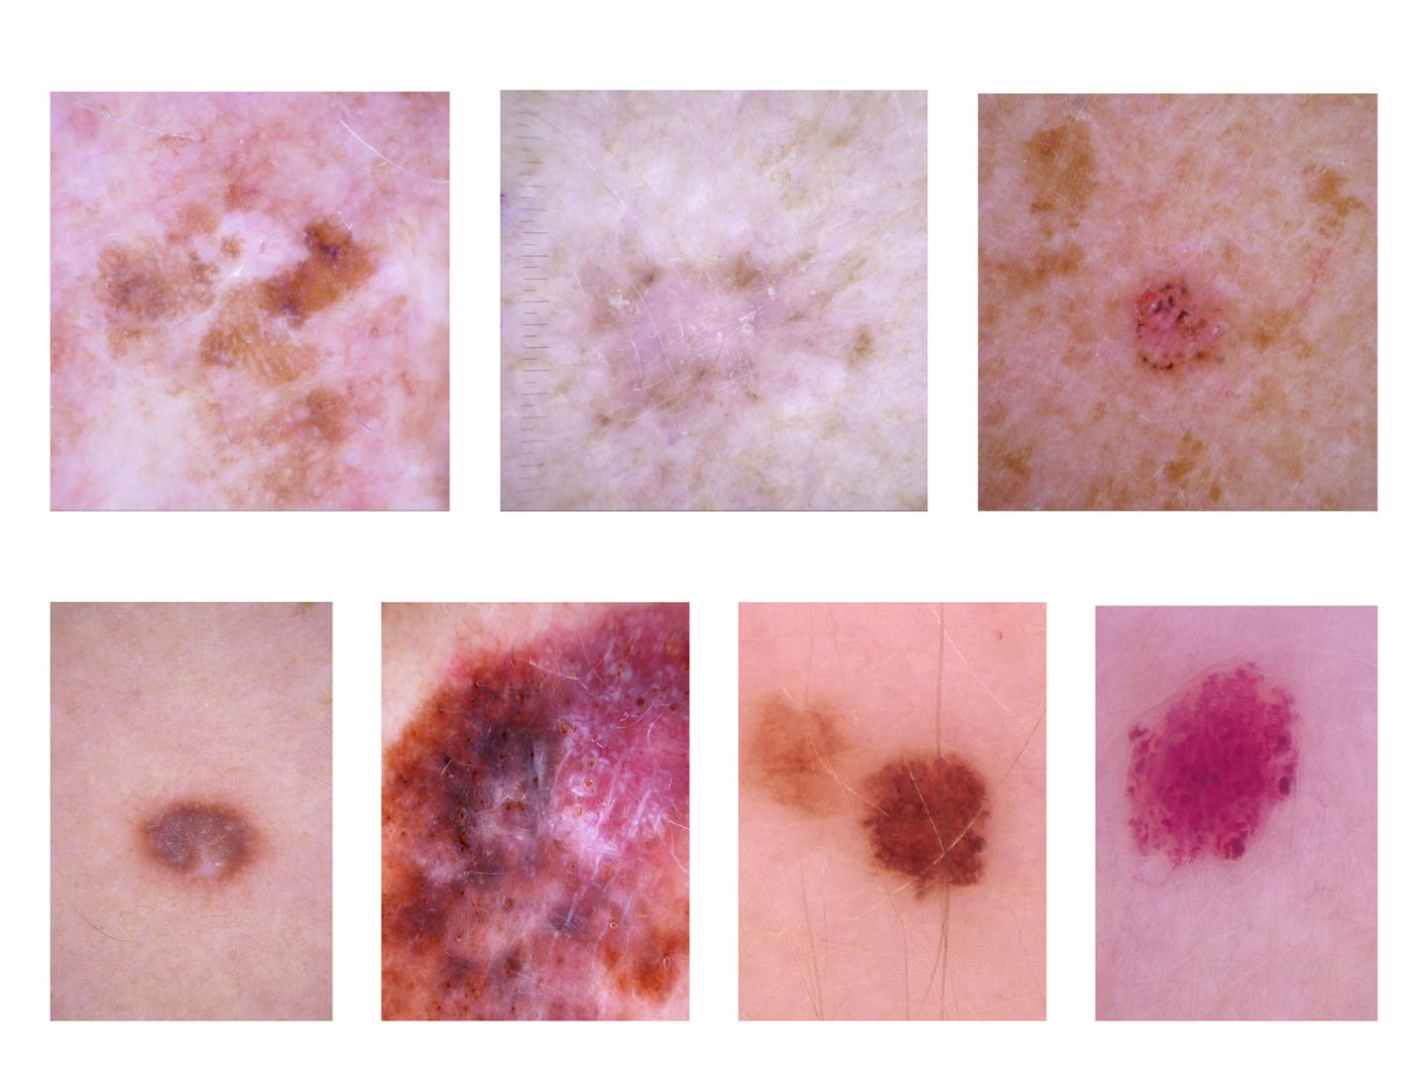
Data Description
Label 0(bkl)
Label 1(akiec)
Label 2 (bcc)
The data we are using is the HAM10000 ("Human Against Machine with 10000 training images") dataset^{[1]}
Label 3(df)
Label 4(mel)
Label 5(nv)
Label 6(vasc)
[1] Philipp, T., 2020. The HAM10000 Dataset, A Large Collection Of Multi-Source Dermato-scopic Images Of Common Pigmented Skin Lesions. [online] Harvard Dataverse. Available at:<https://dataverse.harvard.edu/dataset.xhtml?persistentId=doi:10.7910/DVN/DBW86T> [Ac-cessed 19 April 2020

Slide 4
Data Description
Label 0(bkl)
Label 1(akiec)
Label 2 (bcc)
7-category classification:
1. Benign Keratosis-like Lesions
2. Actinic Keratoses and Intraepithelial Carcinoma/Bowen’s Disease
3. Basal Cell Carcinoma
4. Dermatofibroma
5. Melanoma
6. Melanocytic Nevi
7. vascular lesions
Label 3(df)
Label 4(mel)
Label 5(nv)
Label 6(vasc)

Slide 5
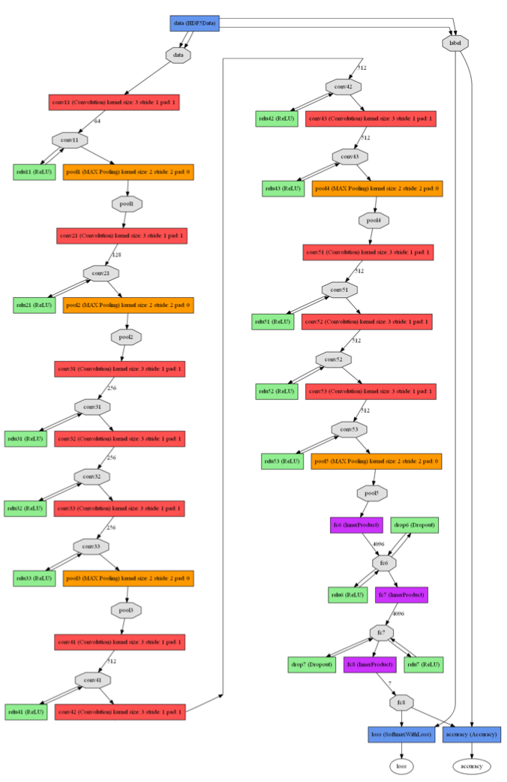
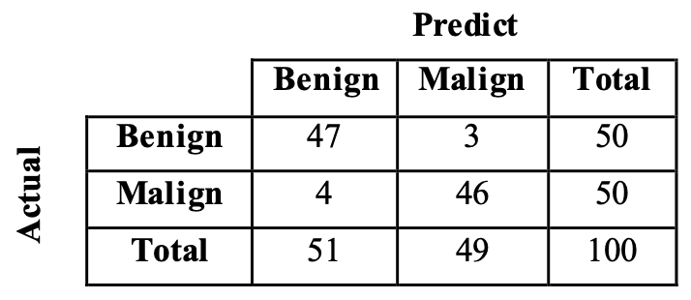

Related Work
Caffe network^{[2]}
Imbalanced dataset^{[1]}
Dropout layers^{[3]}
[1] Ge, Yunhao, et al. "Melanoma segmentation and classification in clinical images using deeplearning." Proceedings of the 2018 10th International Conference on Machine Learning andComputing. 2018.
[2] Nasiri, Sara, et al. "Deep-CLASS at ISIC Machine Learning Challenge 2018." arXiv preprintarXiv:1807.08993 (2018).
[3] M. Siddhartha, "Step wise Approach : CNN Model (77.0344% Accuracy)", Kaggle.com, 2020.[Online]. Available: https://www.kaggle.com/sid321axn/step-wise-approach-cnn-model-77-0344-accuracy#Data-Augmentation. [Accessed: 19- Apr- 2020]

Slide 6
Method
-- Pre-Processing
Sort into 7 labels
Resize images using tensorflow.image.resize method
450x600x3
90x120x3

Slide 7
Method
-- Parameters for iteration strategy
Learning rate: 0.0001
-- after trying 0.001, 0.0002, 0.0005
Epoch: 25
-- after trying 8, 10, 30, 50

Slide 8
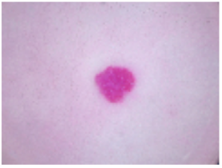
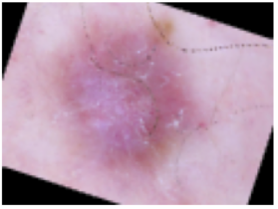
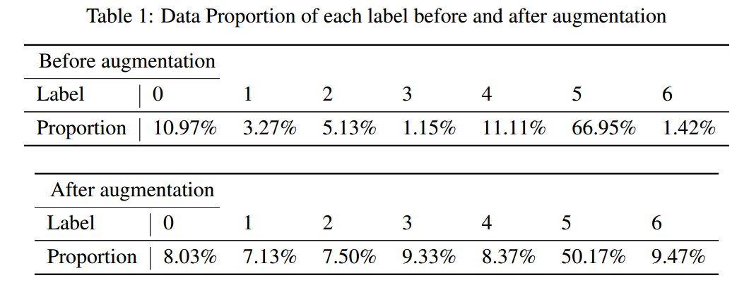
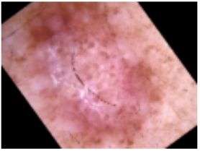
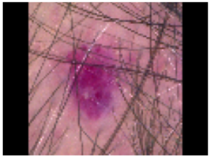
Method
-- Augmentation (Imbalanced data)
Weighted crosstropy loss function
Balanced batching
Augmentation
[7] G. Lemaitre, 2020. Porto Seguro: Balancing Samples In Mini-Batches With Keras [online] Imbalanced-learn.readthedocs.io. Available at: <https://imbalanced-learn.readthedocs.io/en/stable/auto\_examples/applications/porto\_seguro\_keras\_under\_sampling> [Accessed 21 April 2020].

Slide 9
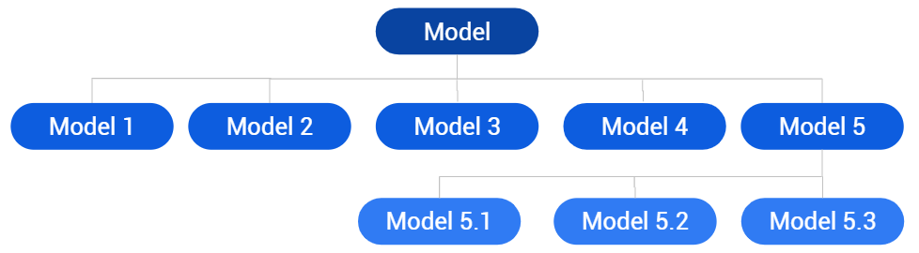
Physical Layer
Model 1: CNN model with physical layers disabled for training
Model 2: CNN model with illumination phase and ‘colorweighing’ layer
Model 3: CNN model with aperture phase and ‘colorweighing’ layer
Model 4: CNN model with illumination phase, aperture phase and ‘colorweighing’ layer
Model 5: CNN model with only ‘colorweighing’ layer
Model 5.1: CNN model with only ‘colorweighing’ layer (Y = 0.299 R + 0.587 G + 0.114B)
Model 5.2: CNN model with only ‘colorweighing’ layer (Y = 0.333 R + 0.333 G + 0.333 B)
Model 5.3: CNN model with only ‘colorweighing’ layer (Random RGB weights)

Slide 10
Physical Layer
Model
Model 1
Model 2
Model 3
Model 4
Model 5
Model 5.1
Model 5.2
Model 5.3
Model 1: CNN model with physical layers disabled for training
Model 2: CNN model with illumination phase and ‘colorweighing’ layer
Model 3: CNN model with aperture phase and ‘colorweighing’ layer
Model 4: CNN model with illumination phase, aperture phase and ‘colorweighing’ layer
Model 5: CNN model with only ‘colorweighing’ layer
Model 5: CNN model with only ‘colorweighing’ layer (Y = 0.299 R + 0.587 G + 0.114B)
Model 5: CNN model with only ‘colorweighing’ layer (Y = 0.333 R + 0.333 G + 0.333 B)
Model 5: CNN model with only ‘colorweighing’ layer (Random RGB weights)

Slide 11
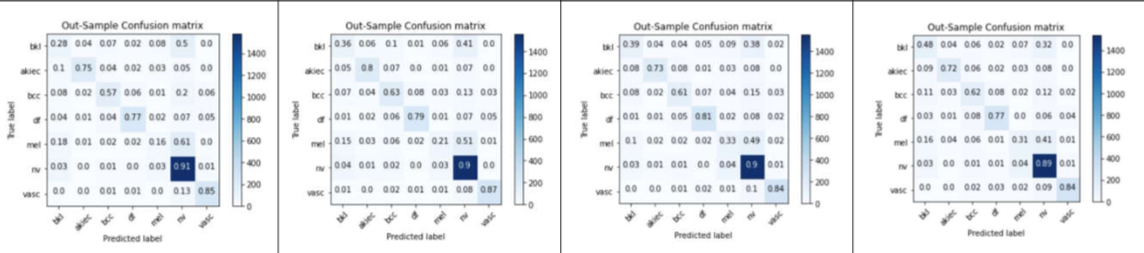
Result
--Confusion Matrix
Without Physical Layer
Models after Optimization

Slide 12
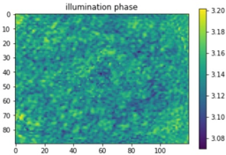
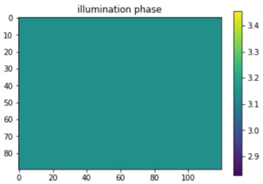
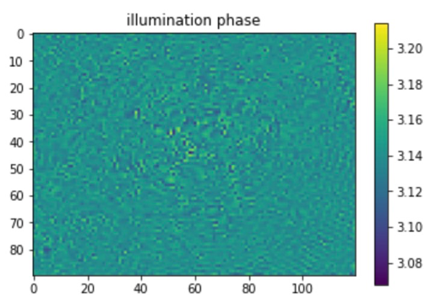
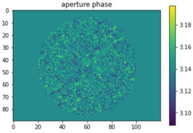
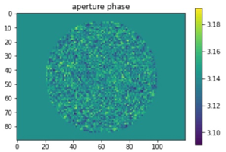
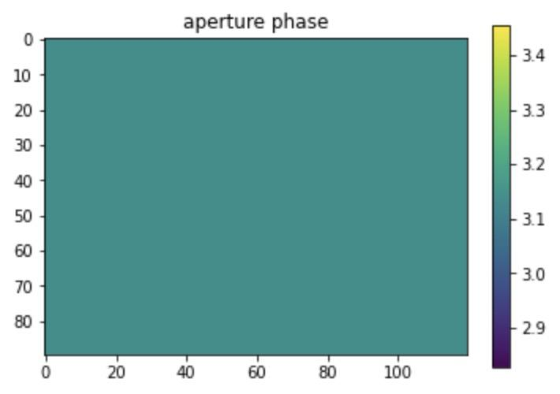
Discussion
Acc: 75.4 %
Acc: 76.6 %
Acc: 76.3 %
Optimization for both
Optimization for only one

Slide 13
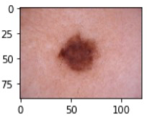
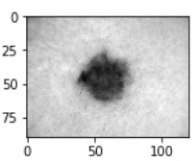
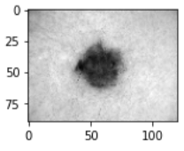
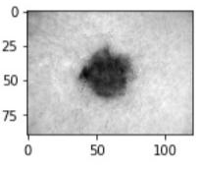
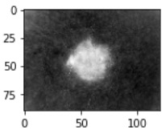
Discussion
Original
rgb2gray
Initial Value: 0.299, 0.587, 0.114
Final Weights: 0.267, 0.621, 0.110
0.333, 0.333, 0.333
0.293, 0.387, 0.338
Random Initial Values
-0.277, -0.972, -0.274

Slide 14
Future Directions
Other features could be extracted, if want to improve accuracy
Regularizers to constrain weights of physical layers
Emsemble model of differently trained models

Slide 15
Thank you for listensing!

